Slide 1
What is Big Data?

Slide 2
Volume
Size of the data being stored
40,000 queries to Google each second
300 hours of new video on YouTube each minute
More than 100 tb of data on Facebook daily
Smart devices produce 5 quintillion bytes of data daily

Slide 3
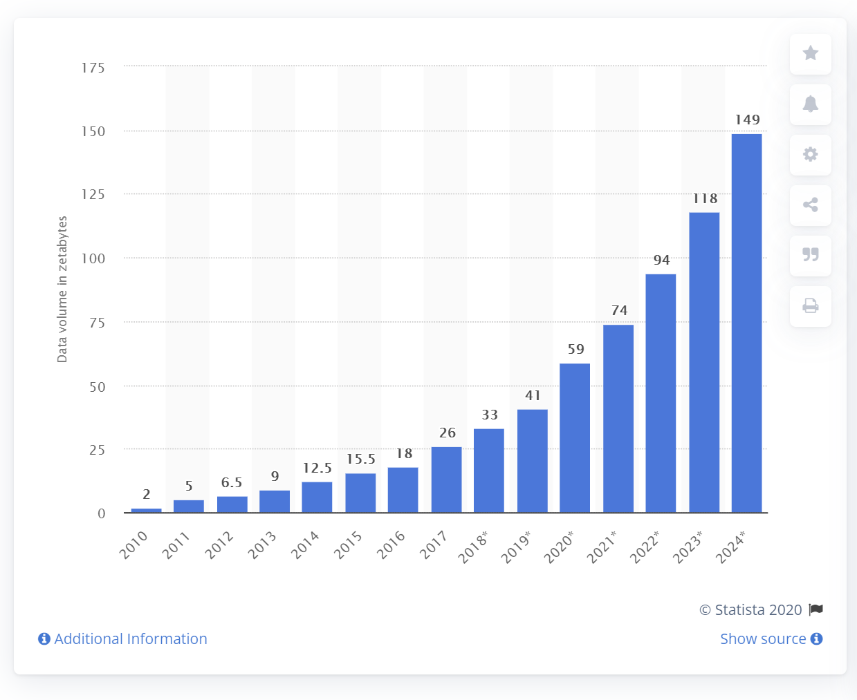
Painting a Picture – in Zettabytes!
Notes:
A zettabyte is a billion terabytes
We are in what is called the “zettabyte era” – hit 1 zb in 2012, and IP traffic hit 1 zb in 2016

Slide 4
What are we doing with all that data?
Nothing!
99.5% of collected data never gets used or analyzed
Less than 50% of IoT data is used in decision making

Slide 5
Variety
Types of Data and how they differ
Video
Audio
Text
The composition each company has of the types of data

Slide 6
Velocity
Speed of data generation and storage
Real-time analysis or consumed later?

Slide 7
Veracity
How trustworthy is your data?
Are there discrepancies? Duplicate records?
How confident are you in making a decision with your data?

Slide 8
Value
Does it provide useful information and insights?
How can you use data to change the world?

Slide 9
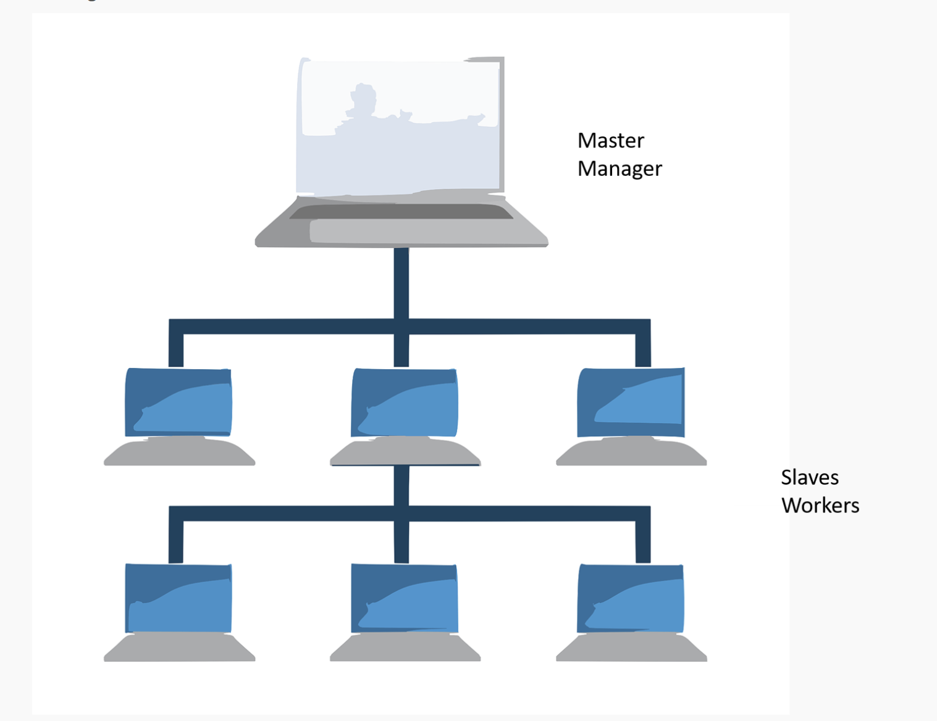
How Distributed Processing Works

Slide 10
About Big Data…
It’s finicky
Companies have their own proprietary software for it
Sampling means you don’t have to use ALL the data

Slide 11
Have a backup!
Redundancy – data stored on a backup
Fault tolerance – resilience

Slide 12
Interacting with Big Data
Hadoop
Google Co-Lab
Amazon Web Services
Cloud-based R & Python
Saturn Cloud
DASK

Slide 13
Questions?

